Slide 1

LIBRARY BOOK LOAN SYSTEM
GRoUP II
Özlem DEMİRTAŞ 21327901
Umut ÖZTÜRK 21328394
Rahmi Berk ŞEFKATLİ 21427402

Slide 2
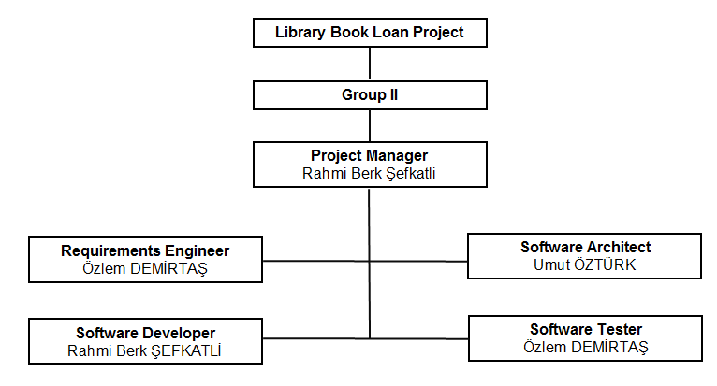
Team Members and Roles

Slide 3
Technologies used in the project
Java programming language (Swing)
Eclipse IDE
MySQL Database Management System
JDBC API
Navicat

Slide 4
Development Model
Plan-driven incremental development model is used in our project. Because deliverables and their schedule are planned before. The system is modified according to the feedbacks from the customer.

Slide 5
Conformance to the Plan
The technologies that are planned in the project are used. (Java, MySQL etc.)
All use cases are developed according to plan.
Functional and system requirements are satisfied.
The milestones have been completed in less time than expected.

Slide 6
GitHub Usage
GitHub is used
To store the modifications in a central repository.
To download a new version of the software and upload the newest revision.
To see new changes, download them and contribute.

